Slide 1
二零一三年三月十四日星期四
现在做
Practice writing U2C.1 vocabularies
with your partner.
Quiz will start in 十分钟
1. characters, pinyin/tones, meaning
2. Answer questions in characters.

Slide 2
U2C.1 小考

Slide 3
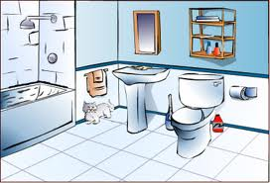
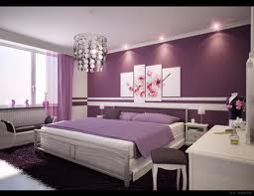

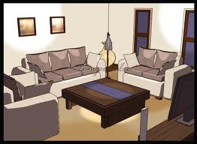
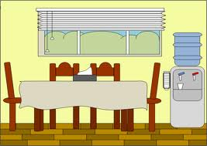
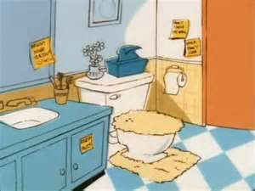
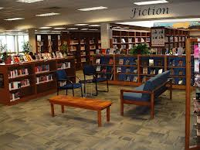
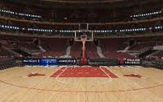
I. Write the room name and its function under the pictures
Ex. 体育馆 --- 打球
(Word bank: 图书馆、卧室、书房、洗手间、客厅、餐厅、体育馆、浴室、洗脸、聊天、
睡觉、学习、吃饭、洗澡、打篮球、看书 )
浴室 洗澡
卧室 睡觉
书房 学习
客厅 聊天
_________ _________ ________ ________ _________ ________ __________ __________
_____ ______ ______ ______ _____ _______ ______ ______
餐厅 吃饭
洗手间 洗脸
图书馆 看书
体育馆 打篮球

Slide 4
II. Fill in the blanks with the measure word in the box
Measure words: 个 口 把 张 枝 间 层 本
六 ______ 书 2. 八 ______ 桌子 3. 五 ______ 人
两 ______ 窗户 5. 十 ______ 纸 6. 六十 ______ 楼
四 ______ 房 8. 三 ______ 铅笔 9. 二十 ______ 椅子
III. Rearrange the words/phrases to form a sentence.
1. 房子/我家/三层/有/的。 ————》__________________________________。
2. 上面/卧室/客厅/我的/在。————》__________________________________。
3.常常/里面/我/书房/在/看书。——》___________________________________。
本
张
口
个
张
层
间
枝
把
我家的房子有三层
我的卧室在客厅上面
我常常在书房里面看书

Slide 5
After learning the following new words, you will create your own sentences by using the following structures and share them with the class
有些 (xiē )…, 有些…: Some…, some…….
Ex.有些人在客厅聊天，有些人在餐厅吃饭。
每一个: All…..
Ex.晚上的时候，每一个人都在卧室里面睡觉。
3. Subject + 在 + Place + VO
Ex. 我在教室上课。

Slide 6
二零一三年三月十五日星期五
现在做
Read the U2C.2 vocab list
Challenge yourself:
How many new vocab do you understand?

Slide 7
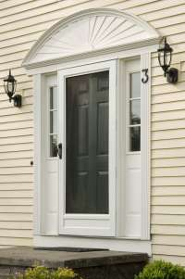
这是什么？
这是前门。
qián mén
front door
Yahoo.com

Slide 8
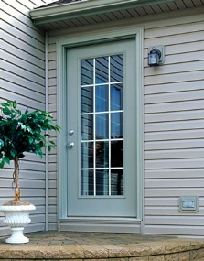
这是什么？
这是后门。
hòu mén
back door
www.brennanexteriors.com

Slide 9
这两个人是谁？
这两个人是客人。
kè rén
visitor(s)

Slide 10
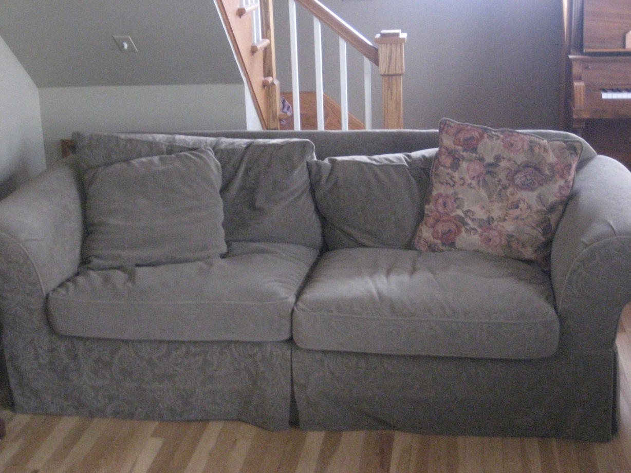
这是什么东西？
这是沙发。
shā fā
sofa

Slide 11
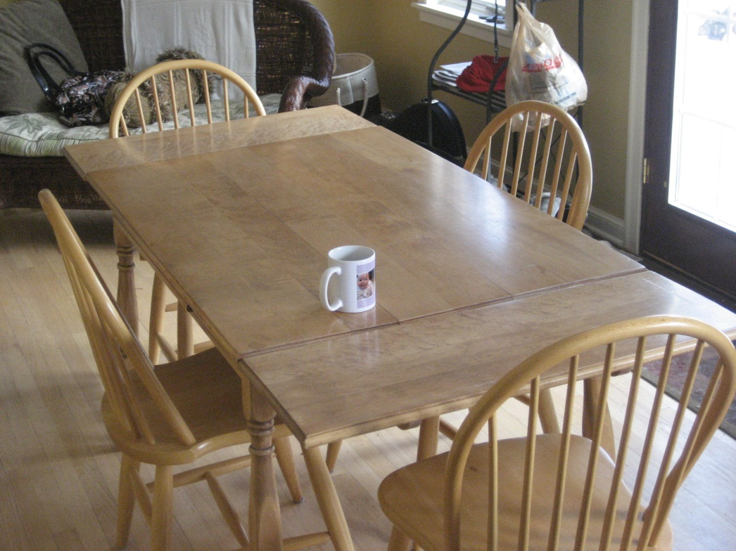
这是什么
东西(dōng xī)？
这是饭桌。
fàn zhuō
table (for eating)

Slide 12
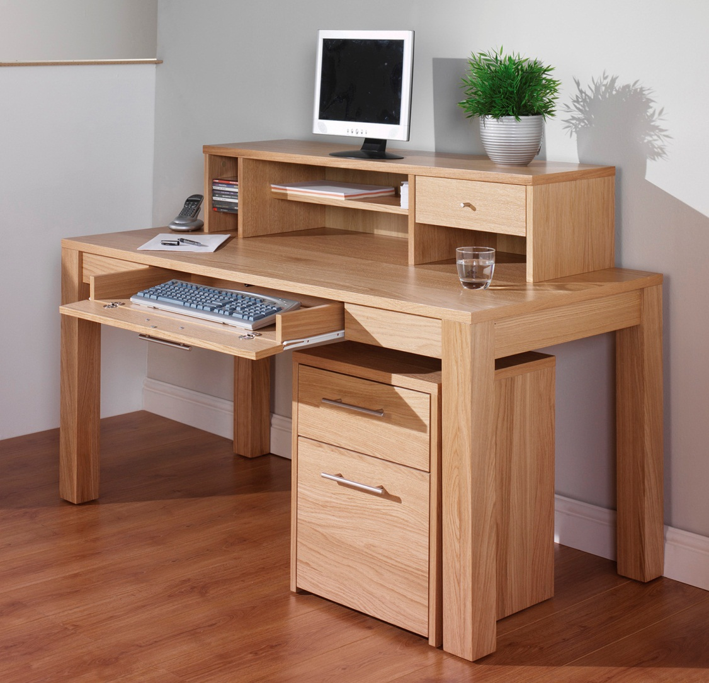
这是什么？
这是书桌。
shū zhuō
desk
Regiscareerservices.com

Slide 13
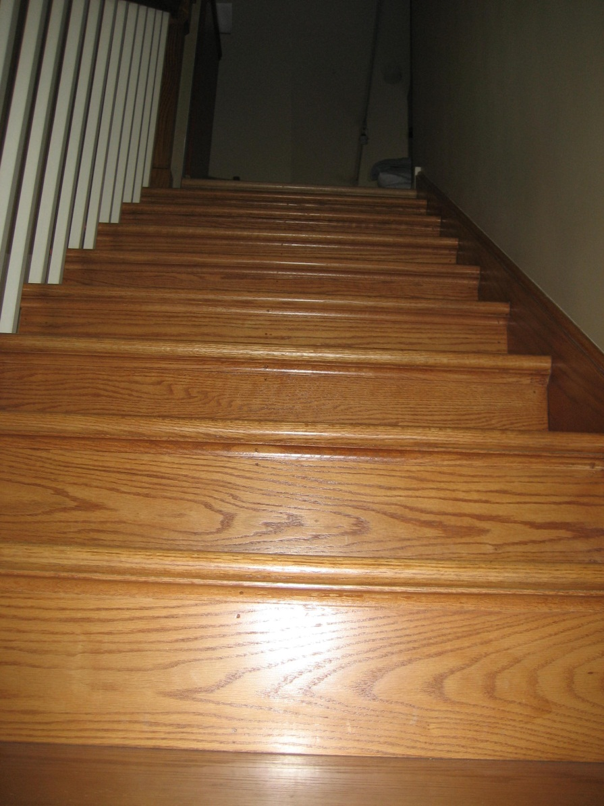
这是什么地方？
这是楼梯。
lóu tī
stairs

Slide 14
这是什么东西？
这是冰箱？
bīng xiāng
refrigerator

Slide 15
这是什么东西？
这是床。
chuáng
bed

Slide 16
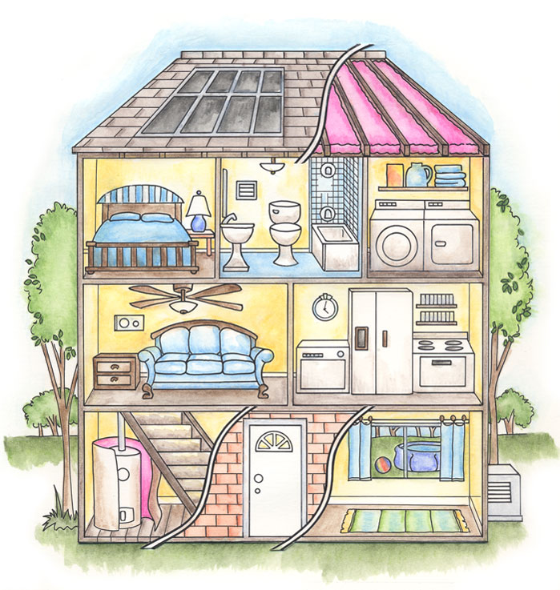
说话练习
跟你的partner回答下列问题。
房子里面有哪些房间？
房间里面有哪些东西？
www.house2harvest.org

Slide 17

Use 有些 and 每一个 to write 5 general
sentences about houses.
Ex. 有些客厅有沙发， 有些没有。
每一个卧室都有床。

Slide 18

Timed Speaking Assessment

Slide 19
Rubric for peer evaluation
Language use
Very weak 0 - 5 | Weak 6 | Adequate 7 | Good 8 | Excellent 9 10
Many errors that obscure meaning, heavy use of English | Four or more errors, significant errors that obscure meaning, use of English | Basic, limited use of vocab/structures, 2-3 errors that do not obscure meaning | Clearly competent use of language, 1 error that does not obscure meaning | Sophisticated use of language with no errors in language use.
Pronunciation and tones
Very weak 0 - 5 | Weak 6 | Adequate 7 | Good 8 | Excellent 9 10
Very frequent pronunciation errors that obscure meaning and require significant listener effort | Four or more errors in pronunciation and tones that obscure meaning and require some listener effort | 2-3 errors in pronunciation and tones, or lack of emphasis, that do not obscure meaning | Accurate pronunciation and tones with no more than 1 error that does not obscure meaning | Accurate use of pronunciation and tones with no errors
Delivery/fluency
Very weak 0 - 5 | Weak 6 | Adequate 7 | Good 8 | Excellent 9 10
Very labored pace and intonation, with extended silences, constant hesitation, or significant repetition | Inconsistent pace and intonation, frequent hesitation and repetition | Consistent pace and intonation with some hesitation that does not obscure meaning | Generally smooth pace and intonation with minimal hesitation | Natural pace and intonation with no hesitation/repetition

